Slide 1


Go Faster Sooner! Discover SQL Server index prescriptions for the biggest performance improvements
July 19 2025
Bill Sanscrainte Bill@Sanscrainte.com
Get this presentation, Excel spreadsheet, & T-SQL code at
https://github.com/SQLXL/SQLXL
Notes:
*00:00*

Slide 2



November 17- 21, 2025 in Seattle, WA
https://passdatacommunitysummit.com/
Notes:
*00:30*

Slide 3

About Me
Bill Sanscrainte linkedin.com/in/billsanscrainte Bill@Sanscrainte.com
SQL Server since 6.5
1984 - First SQL statement
1994 - Started Data Consulting practice
2001 - Began version 1 of SQLXL tools
2020 - Retired to pursue SQL Server passion projects
Record holder for most SQL Cruises as a student SQL Server 10 Oracle 2
* Ask questions at any time! *
Notes:
*00:45*
SQL: Metaphor on Britton-Lee

Slide 4

Why are we here?
“Poorly designed indexes and a lack of indexes are primary sources of database application bottlenecks”
learn.microsoft.com 5/19/2025
Notes:
*01:15*

Slide 5

Client Story - Once Upon a Time
Business: Membership & Event Management services
Application: Has “always” been “slow” and getting “slower”
Problem: SQL Server “failed” when really busy
Notes:
*01:45*
Restarted server
3 days to recover - untangle members, events, and payments
Lost several big customers
Begin by asking focusing Questions
AWS via “Lift & Shift” from on-premise
SQL 2016 Enterprise
32 cores / 240GB RAM 2TB data
No SQL monitoring tools

Slide 6
Client Story - A quick check-up revealed …
Business
No money for hardware
No staff for code refactoring & testing
SQL Server
Poison waits – RESOURCE_SEMAPHORE, THREADPOOL
SOS_SCHEDULER_YIELD waits
Lock & Latch waits
SQL Enterprise Edition – online index maintenance!
* All signs point to Index Tuning! *
Notes:
*02:15*
RESOURCE_SEMAPHORE – Brent Ozar “SQL Server ran out of available memory to run queries”
THREADPOOL – Brent Ozar “SQL Server ran out of worker threads, and new queries thought the SQL Server was frozen solid”
CMEMTHREAD - Paul Randall “worker thread is waiting for access to a critical section of code”
- Brent Ozar “servers with a lot of CPU cores that still have their parallelism settings set at their defaults”

Slide 7

My Index Tuning Journey
Back in the Day …
Download SQL Community scripts, copy/paste results, seek actionable nuggets
Notes:
*##:%%*

Slide 8

Thanks to These and All Community Contributors!
Brent Ozar Tim Ford Kevin Kline Jes Borland Tom Collins Pinal Dave Gail Shaw Pedro Lopes Dave Bland | Erik Darling Kendra Little Grant Fritchey Sean McCown Phil Factor Kalen Delaney Jason Strate Jared Westover Percy Reyes | Glenn Berry Kimberly Tripp Andy Yun Paul Randall Ola Hallengren Edward Pollack Ahmad Yaseen Evgeniy Gribkov Denny Cherry | Aaron Bertrand Niko Neugebauer Jonathan Kehayias Monica Rathbun Dmitri Korotkevitch Kendall vanDyke Thomas LaRock Torsten Strauß Rebecca Hirschfield
Notes:
*##:%%*
Shout out to these and others whose community contributions went into this presentation

Slide 9
My Index Tuning Journey - Continued
Back in the Day …
Download SQL Community scripts, copy/paste results, seek actionable nuggets
Building Skills
Linked SQL Server to Excel to quickly format and analyze query results
Combined “best of” community index scripts
Extend capture of metadata, statistics, foreign keys, constraints, metrics
Included details on non-rowstore index, history tables, internal tables
Notes:
*##:%%*

Slide 10

SQL Server Index Tuning – Raw Ingredients
Instance @@ Functions DATABASEPROPERTYEX Function DBCC TRACESTATUS SERVERPROPERTY Function sys.availability_replicas sys.change_tracking_databases sys.configurations sys.database_scoped_configurations sys.database_service_objectives sys.databases sys.dm_db_index_operational_stats sys.dm_db_index_usage_stats sys.dm_db_missing_index_columns sys.dm_db_missing_index_details sys.dm_db_missing_index_group_stats sys.dm_db_missing_index_group_stats_query sys.dm_db_missing_index_groups sys.dm_exec_query_plan sys.dm_exec_query_stats sys.dm_exec_sessions sys.dm_exec_sql_text sys.dm_hadr_availability_replica_states sys.dm_hadr_database_replica_states sys.dm_os_buffer_descriptors sys.dm_os_sys_info sys.servers Database cdc.change_table DBCC SHOW_STATISTICS sys.allocation_units sys.change_tracking_tables | sys.check_constraints sys.column_store_row_groups sys.columns sys.computed_columns sys.data_spaces sys.database_automatic_tuning_options sys.database_files sys.database_query_store_options sys.database_scoped_configurations sys.default_constraints sys.dm_db_column_store_row_group_operational_stats sys.dm_db_column_store_row_groups sys.dm_db_column_store_row_group_physical_stats sys.dm_db_incremental_stats_properties sys.dm_db_partition_stats sys.dm_db_stats_properties sys.dm_db_xtp_hash_index_stats sys.dm_db_xtp_index_stats sys.dm_db_xtp_memory_consumers sys.dm_db_xtp_Nonclustered_index_stats sys.dm_db_xtp_object_stats sys.dm_db_xtp_table_memory_stats sys.dm_exec_sessions sys.dm_sql_referencing_entities sys.dm_xtp_system_memory_consumers sys.edge_constraint_clauses sys.edge_constraints sys.extended_properties sys.filegroups sys.foreign_key_columns sys.foreign_keys sys.fulltext_catalogs sys.fulltext_index_columns sys.fulltext_indexes | sys.fulltext_languages sys.function_order_columns sys.hash_indexes sys.identity_columns sys.index_columns sys.index_resumable_operations sys.indexes sys.internal_partitions sys.internal_tables sys.key_constraints sys.objects sys.partition_functions sys.partition_schemes sys.partitions sys.periods sys.schemas sys.sequences sys.spatial_index_tessellations sys.spatial_indexes sys.sql_expression_dependencies sys.sql_modules sys.stats sys.stats_columns sys.table_types sys.tables sys.triggers sys.types sys.views sys.xml_indexes sys.xtp_memory_consumers sys.xtp_nonclustered_index_stats sys.xtp_object_stats
Notes:
*##:%%*
96 DMVs & DMFs
Nearly 1000 columns
Almost 200 performance & hurt metrics

Slide 11
My Index Tuning Journey - Continued
Back in the Day …
Download SQL Community scripts, copy/paste results, seek actionable nuggets
Building Skills
Linked SQL Server to Excel to format and analyze query results
Combined “best of” community index scripts
Extend capture of metadata, statistics, foreign keys, constraints, metrics
Included non-rowstore index details, history tables, internal tables
Stitched it all together by table & index
Created SQLXL_Index!
Notes:
*##:%%*

Slide 12
Why SQLXL_Index?
Comprehensive metadata & metrics
Extensive diagnostics
Recommend detailed index tuning actions
Prioritize highest priority tables for tuning

Slide 13

How do we Prioritize Index Tuning?
80% of results from 20% of effort
Applying Pareto’s Principle to indexes
SQL Server tracks performance “hurts” by index
Add up “hurts” by table
Fix most “hurting” tables first
Notes:
*##:%%*
80 metrics of “hurt”

Slide 14

Client Story - Index Tuning Priorities
82% of hurt
4% of tables
Notes:
*##:%%*
21 tables
Stunning insight - a lot less work to make significant improvement in performance
YMMV

Slide 15
Metrics of Index Hurt
Category Measures Notes
Waits Count, Time
Locks Count Includes promotions and fails
Splits Count Adds overhead
Merges Count Adds overhead
Missing Count, Cost, Savings Weighted by % total tables reads
Writes Count
Notes:
*##:%%*

Slide 16
Metrics of Index Hurt - Continued
Category Measures Notes
Buffer % in memory
Reads/Writes Reads/Writes Writes have way way more overhead
Scans Count Excludes columnstore
Lookups Count
Heaps Count Forward Fetches
LOBs Count offrow LOB actions
Notes:
*##:%%*

Slide 17

Hurt Weighting - Runtime Defaults
Waits ++++++
Locks +++
Splits +++++
Merges +++++
Missing ++++
Writes +++
Buffer +++++
Read/write ++++
Scans ++++
Lookups ++
Fetches +++
LOB +
In-Memory - - -
Notes:
*##:%%*
Parameterized in SQLXL_Index
19 different values
Reflect your server’s operational metrics
Aggregated to Table level

Slide 18
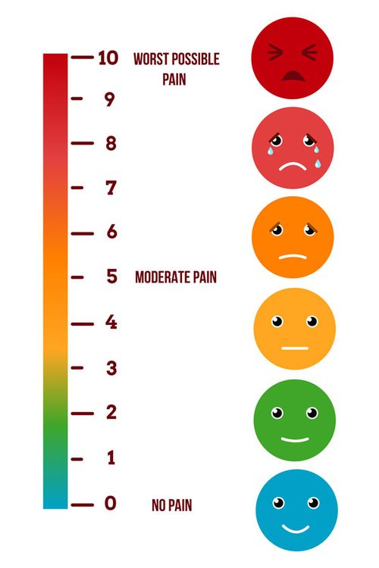
Prioritizing the Hurt – Applying Weighting
For each hurt metric
Add up index hurts to table
Total all tables
Compute each table’s percent of total
Apply hurt weighting factor
Total up weighted metrics by table
Present results in descending order of hurt
Notes:
*##:%%*
Why by table - it’s where the data lives

Slide 19
Executing SQLXL_Index
Download spreadsheet SQLXL.xlsm from https://github.com/SQLXL/SQLXL
Copy & execute SQL creation script
Execute [##SQLXL_Index] procedure
Parameters
Database - default “All User”
Foreign Keys - default cover “TRUSTED, ENABLED, REPLICATED”
Nonclustered Columnstore - default “Create” for enterprise edition 2016+
Hurt weightings - modify for your specific environment
Click “Get SQL Data” button in spreadsheet
Review & execute prioritized recommendations
Go faster!

Slide 20
SQLXL_Index – Priority Tables
Demo
Notes:
350 steps
Hundreds of columns
Dropdown
Buttons
Hurts - color coded
Blanks – no data or unused
*SORTS*
Table Name & Object Type
Final Score

Slide 21

Client Story – What steps do we follow to make the hurt go away!
Retain Replace Request Reject | Remove Review Refresh Refactor
Notes:
*22:00*
“Show All Rows”
Switch to “Index Hurt & Prescriptions”

Slide 22
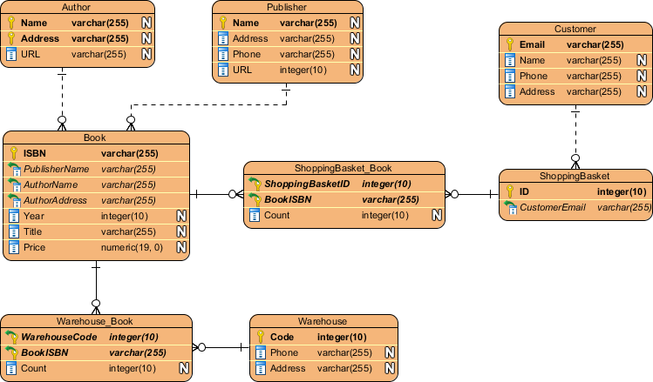
Recommendation Categories
Retain
Replace
Request
Reject
Remove
Review
Refresh
Refactor
Keep existing indexes “As Architected & Designed”
Clustered
Constraints - primary key, unique, foreign key
Specials - full-text, spatial, XML, JSON, columnstore, hash
History - Change Data Capture, System Versioned, Ledger
Internal Tables
Required by others
e.g. unique index supporting full-text
Notes:
*29:45*

Slide 23

Recommendation Categories
Retain
Replace
Request
Reject
Remove
Review
Refresh
Refactor
New in SQL 2016+ Enterprise: updatable nonclustered columnstore
Replace existing nonclustered rowstore indexes
Low usage
Low read/write ratio
Low value Missing indexes
Notes:
*30:15*

Slide 24

Recommendation Categories
Retain
Replace
Request
Reject
Remove
Review
Refresh
Refactor
Create New Index
Clustered indexes on active heaps
Valuable missing indexes
Foreign key covers
Updatable nonclustered columnstores (SQL 2016E+)
Notes:
*30:45*

Slide 25

“Fine Print” on Missing Index Limitations (from Microsoft)
Only recommends nonclustered, rowstore, disk-based indexes
No clustered, columnstore, in-memory, partitioned, compressed, XML, JSON, spatial, full-text, hash, unique, filtered, materialized views …
Only creates estimates from a single query optimization
Not weighted based on total number of times table was accessed
Cleared for a table on DDL change or index add/change/delete/rebuild
Only first 600 captured, additional estimates not stored
Ignores key column selectivity, keys listed instead by table column creation order
Does not consider existing nonclustered columnstore in deciding on a “missing” index
No consideration for key column parameter sniffing
Does not update query metrics after actual execution(s)
Does not consider cost / benefit ratio when suggesting included columns to cover query
No knowledge of existing indexes or other recommendations - creates overlaps!
No suggestions for trivial (“simple”) query plans
Suggests missing indexes for imprecise and non-persisted computed columns
Only one returned from each query, even if many were suggested in plan XML
Queries with only inequality predicates have less accurate query cost
Ignores internal tables (e.g. supporting full text, XML, & spatial indexes)
Ignores history tables (CDC, SVN, LDG)
Notes:
Why this slide?
Always find overlapping indexes created from Missing Index recommendations
Giveaway – same keys different included columns

Slide 26

Recommendation Categories
Retain
Replace
Request
Reject
Remove
Review
Refresh
Refactor
Missing index recommendations
That don’t add significant value
Covered by (existing/future) nonclustered columnstore
Notes:
*31:15*
Especially once weighted by share of reads

Slide 27

Recommendation Categories
Retain
Replace
Request
Reject
Remove
Review
Refresh
Refactor
Drop existing nonclustered rowstore indexes
Cost more than benefit - less than 4 reads per write
Least used Duplicated
Redundant foreign key constraint
Notes:
*31:45*
Same keys same sequence
Same keys different sequence (“overlap”)
Keys “contained” in another bigger index

Slide 28

Recommendation Categories
Retain
Replace
Request
Reject
Remove
Review
Refresh
Refactor
“It Depends” for indexes tagged previously - like:
Potential filtered index - wide range of rows per lead index key
Synergies & overlaps (with included columns)
Non-persisted computed column in index
Potential temporary based on name
High page compression failures
Disabled / Not trusted
Notes:
*32:15*

Slide 29

Recommendation Categories
Retain
Replace
Request
Reject
Remove
Review
Refresh
Refactor
Refresh index statistics with
row modification counts
row count not matching table row count
Rebuild / reorganize columnstores with
delta stores (update, delete)
multiple undersized rowgroups
Notes:
*32:45*

Slide 30

Recommendation Categories
Retain
Replace
Request
Reject
Remove
Review
Refresh
Refactor
Retained indexes benefiting from structural changes:
Rowstore - more key(s) don’t improve selectivity
FILL FACTOR = 100% with hi page splits (and opposite)
Index partition not match table partition
Collation mismatch
Page / row locking not enabled
Clustered rowstore index not “NUSE”
Narrow
Unique
Static
Ever increasing
Notes:
*33:15*

Slide 31
SQLXL_Index - Recommendations
Demo
Notes:
History tables roll up (CDC,SVN,LDG)
Internal Tables roll up (FTX,SPT,XML)

Slide 32

Client Story – Implementing Recommendations
Disable index maintenance jobs – resets operational metrics
Weekly server maintenance restart & run business
At end of week build “before” baseline
Apply recommendations to 4% (21) of tables
Weekly server maintenance restart & run business
End of week capture “after” statistics
Compare “after” to “before”
Note: “mostly similar” non-peak workloads
Notes:
*##:##*
Under-represent indexes getting rebuilt regularly

Slide 33

Client Story - SQL Wait Improvements versus Previous Week
System Waits
RESOURCE_SEMAPHORE -71%
THREADPOOL -67%
SOS_SCHEDULER_YIELD -63%
LCK_* & PAGELATCH_* -52%
Index Hurts
Waits - times & counts -77%
Locks - count, promotions -62%
Scans & lookups -58%
Read / Write ratio -47%
Writes -43%
Splits, merges, LOB -39%
Buffer cache usage - 0%
Notes:
*34:45* YMMV
Why not 80% - exposed next level of waits & hurts

Slide 34

… But it’s not all Rainbows & Unicorns
Performance metrics, Missing Indexes, Statistics can get reset or dropped on:
Instance start/restart
Database Offline/Online (beware AUTO_CLOSE = ON)
Database Detach/Attach
Memory pressure / metadata cache clearance
Index rebuilds:
Operational Metrics
Usage Metrics < 2012 SP2-CU12 or SP3+ < 2014 SP2
Index metadata changes (create/change/drop)
Index disable/enable
AUTO_UPDATE_STATISTICS

Slide 35

Why Do It? – 575+ Diagnostics (SQL version aware)
“Good to know”- like
Dates: Last read / written / modified / created / statistics updated …
“Key” configuration properties
server, instance, database, query store …
Items that “stand out” - like
Non-default properties, settings, parameters
High proportion of a hurt or other metric
e.g. waits, locks, splits, merges
Anti-Patterns - like
Big included columns
Uncovered foreign keys
with missing index recommendations
Link to Brent Ozar’s 58 sp_BlitzIndex “Checks”
Notes:
*37:00*
Non-Default - Cost threshold for Parallelism
History and Internal Tables given a pass (mostly)
Version Aware - don’t ding SQL 2012 for new feature in SQL 2022
Link to BlitzIndex when same item found (58 items)

Slide 36
SQLXL_Index – Detailed Diagnostics
Demo
Notes:
*38:00*
*04:15*
Squeeze! Into smallest possible space
Avoid scrolling

Slide 37

Metadata & Metrics?
Hundreds of columns - details on
Index keys & included columns
Foreign key constraints
Table & column constraints
Statistics names and filter definitions
Extended properties
All Usage & Operational metrics
Metadata - index, table, database, instance
Notes:
*42:15*

Slide 38
SQLXL_Index - Metadata
Demo
Notes:
*38:00*
*04:15*
Squeeze! Into smallest possible space
Avoid scrolling

Slide 39

Execution
38 seconds on client
Versions
Boxed product 2012+
Azure SQL Database
Azure SQL Managed Instance
Connections
Direct to Excel
Jump Box & export/import into Excel
Notes:
*36:00*
How did we come up with prescriptions? We diagnosed the symptoms.

Slide 40

Applying Index Fixes
Create 2 clones of database structure (1 for current state, 1 to make changes to)
Apply changes to clone & create delta scripts using DDL comparison tool
Plan for tons of log file
Incrementalism - batch changes by table
Expedites (inevitable) rollbacks
Consider DISABLE before dropping
Check secondary before dropping!
Apply delta scripts to target database
Re-compare “end state” to target database
Address any discrepancies
Create “rollback” from clone if SHTF
Notes:
*51:00*
Depending on where problem occurs at what stage in the process, rollback code may be incomplete
Many DDL comparison tools batch up all related activities - can be difficult to unwind if failure

Slide 41

Client Story - They Lived Happily Ever After
Good News - even bigger event SQL CPU max 32%, no issues reported
Even more better - No performance complaints!
Completed most of the remaining index prescriptions, including:
Replaced least-used indexes with nonclustered columnstores
Removed
indexes not adding value
Redundant/overlap indexes
Requested
high-value missing indexes
clusters on heaps
foreign key covers
Notes:
*52:00*

Slide 42

Please fill out the Session Evaluation!
Notes:
*58:50*
Session Evaluations

Slide 43
Thanks for Attending!
Bill Sanscrainte
linkedin.com/in/billsanscrainte & Bill@Sanscrainte.com
Presentation, spreadsheet, & T-SQL
https://github.com/SQLXL/SQLXL
Also See:
Brent Ozar’s sp_BlitzIndex & sp_BlitzIndex Check documentation
Erik Darling’s sp_IndexCleanup
Glenn Berry’s 89 (2022) Diagnostic Information Queries
Aaron Bertrand’s 40 table property queries
Book: Expert Performance Indexing in Azure SQL and SQL Server 2022
Notes:
59:00

Slide 45




SQL Saturday
sqlsaturday.com
linkedin.com/company/sqlsaturday
Data Saturdays
datasaturdays.com
Data Driven Technologies
datadriventechnologies.org
Azure Data Tech Groups
meetup.com/pro/azuredatatechgroups

